Slide 1



Coronavirus Pandemic (COVID-19) Dashboard
Project 3
Hannah Hill – Sahar Jamal – Neda Mehdizadeh
Notes:
It is known that infection with SARS-CoV-2, the virus that causes COVID-19, can result in a range of illnesses, from mild symptoms to severe illness and death. About 30% of persons infected with SARS-CoV-2 do not have symptoms.

Slide 2



COVID-19 and Vaccine Basics
The combination of getting vaccinated and following CDC recommendations to protect yourself and others offers the best protection from COVID-19.
Cover your nose and mouth with a mask.
Stay at least 6 feet from people who don’t live with you.
Avoid crowds and poorly ventilated indoor spaces.
Wash your hands.
Getting vaccinated can help prevent getting sick with COVID-19
Getting vaccinated can help prevent getting sick with COVID-19
COVID-19 vaccines will not cause you to test positive on COVID-19 viral tests

Slide 3
COVID-19 and Vaccine Data Dashboard
In this dashboard we present trends for the 2020-2021 data regarding COVID-19:
Get an overview of the pandemic for any country on a single page
Explore the global datasets on covid vaccination
Explore the data confirmed Covid-19 cases for all countries
Explore metrics like total life expectancy, total hospital beds and human development index in each country
Our dashboard would be useful for travelers or those interested in researching the COVID-19 pandemic and its trends.

Slide 4
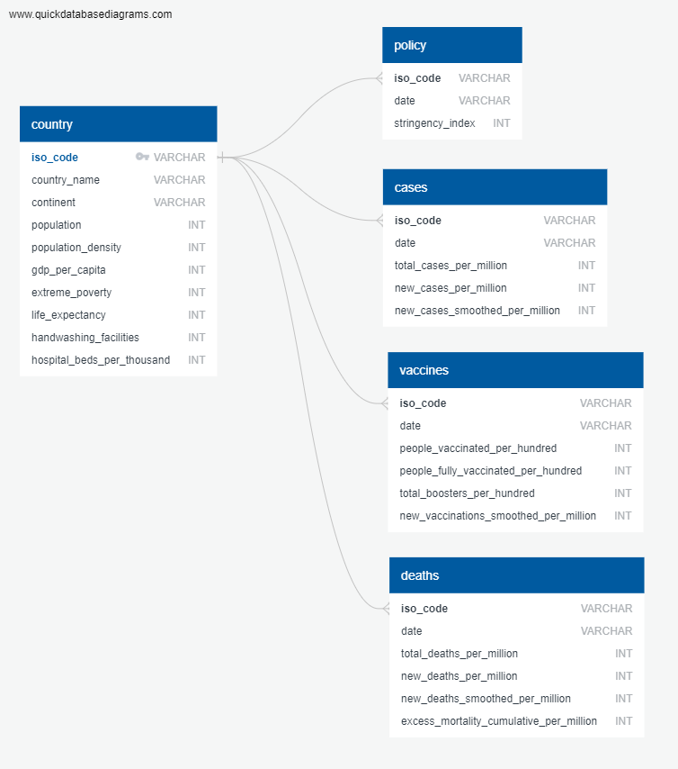
ERD

Slide 5

Source of Data
We obtained Data as a csv file from : https://ourworldindata.org/coronavirus
Steps:
Load Data on Jupiter notebook
Cleaned the data and created the data frames with the most recent data
Created json files for the Data :
df1.to_json('./export.json', orient='records')

Slide 6
A choropleth map creation
Hannah tell your story her ☺

Slide 7
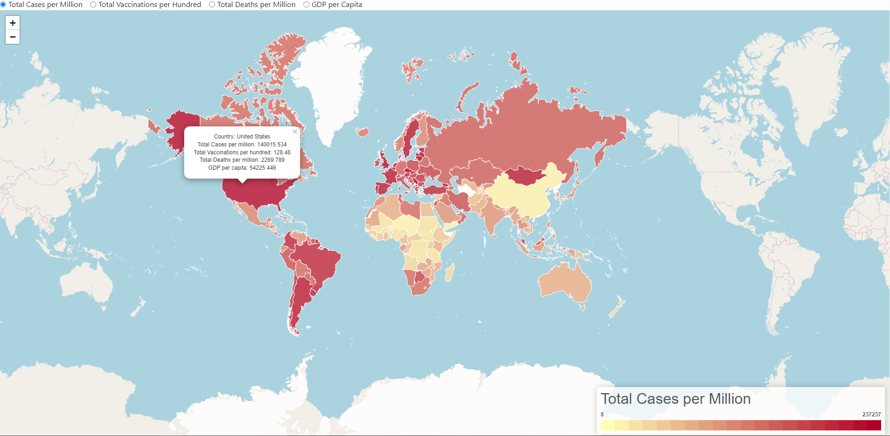
A choropleth map – Total Cases per million

Slide 8
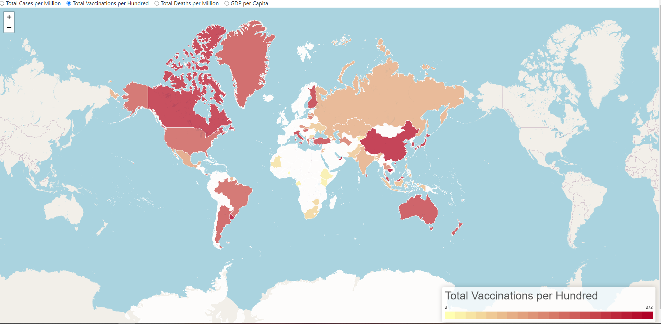
A choropleth map – Total vaccination per hundred

Slide 9
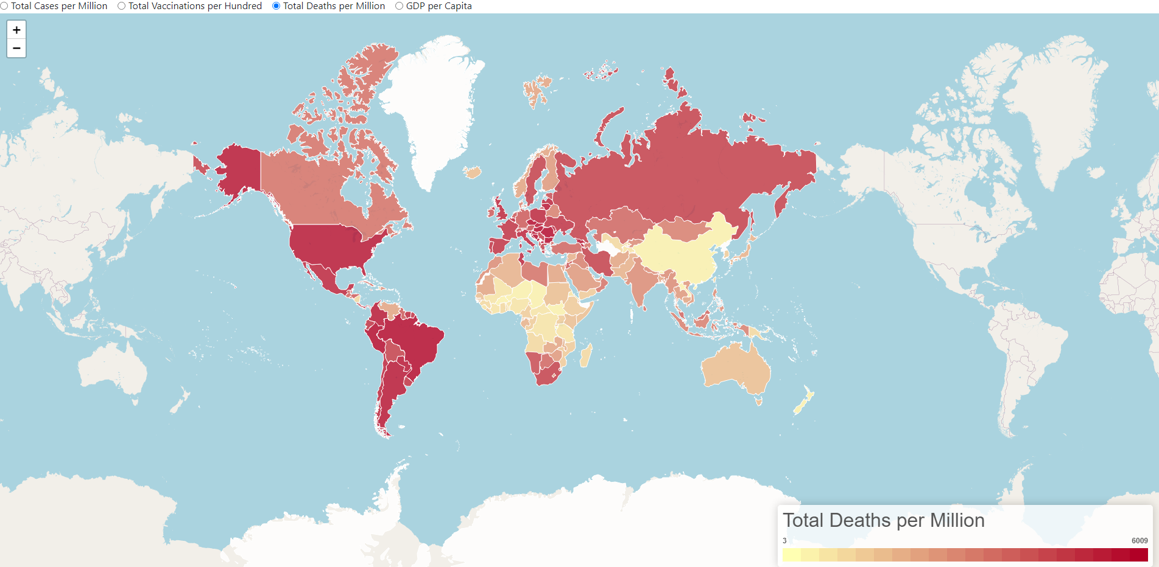
A choropleth map – Total Deaths per Million

Slide 10
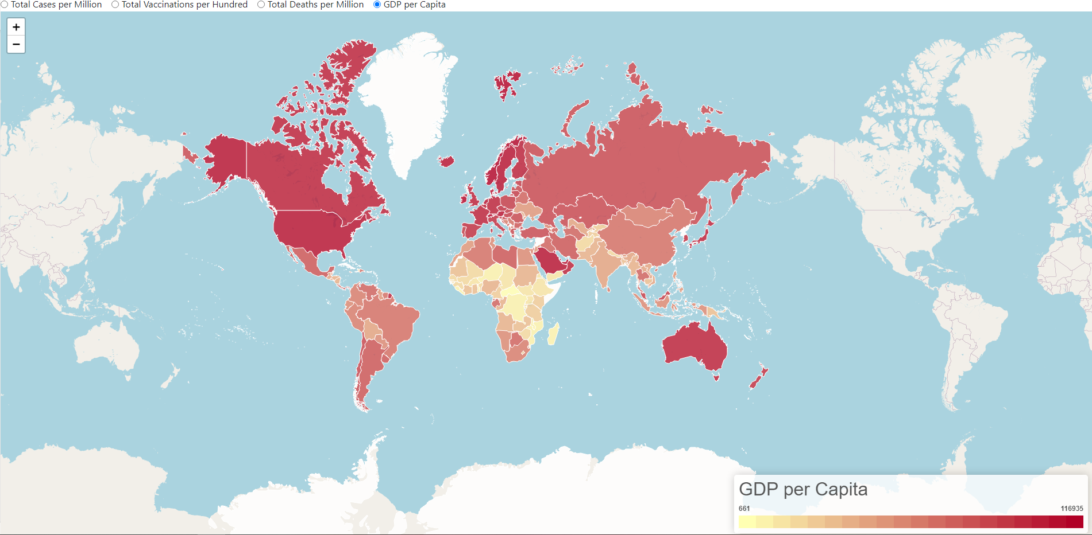
A choropleth map – GDP per Capita

Slide 11
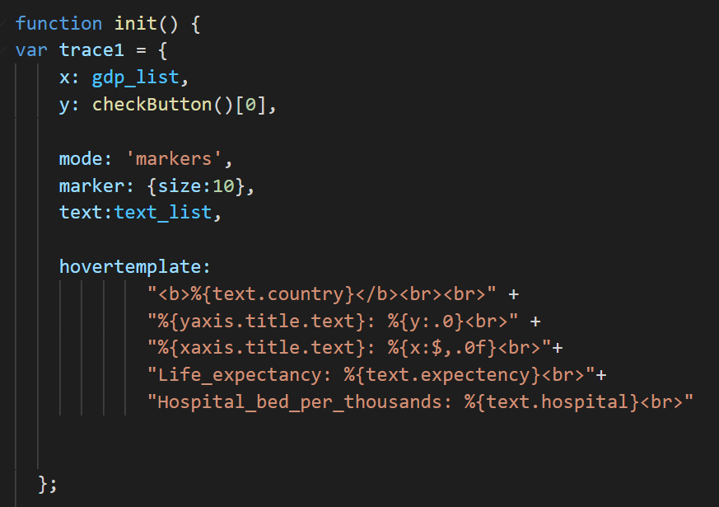
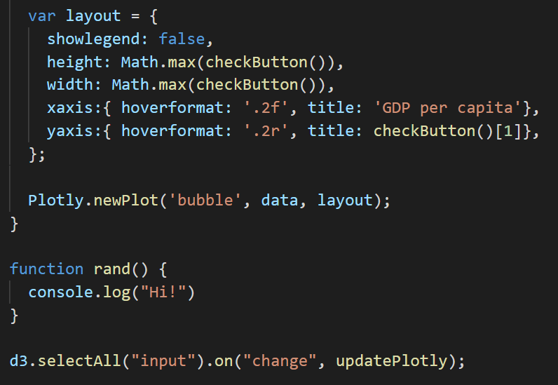
Interactive Scatter Plot - Code

Slide 12
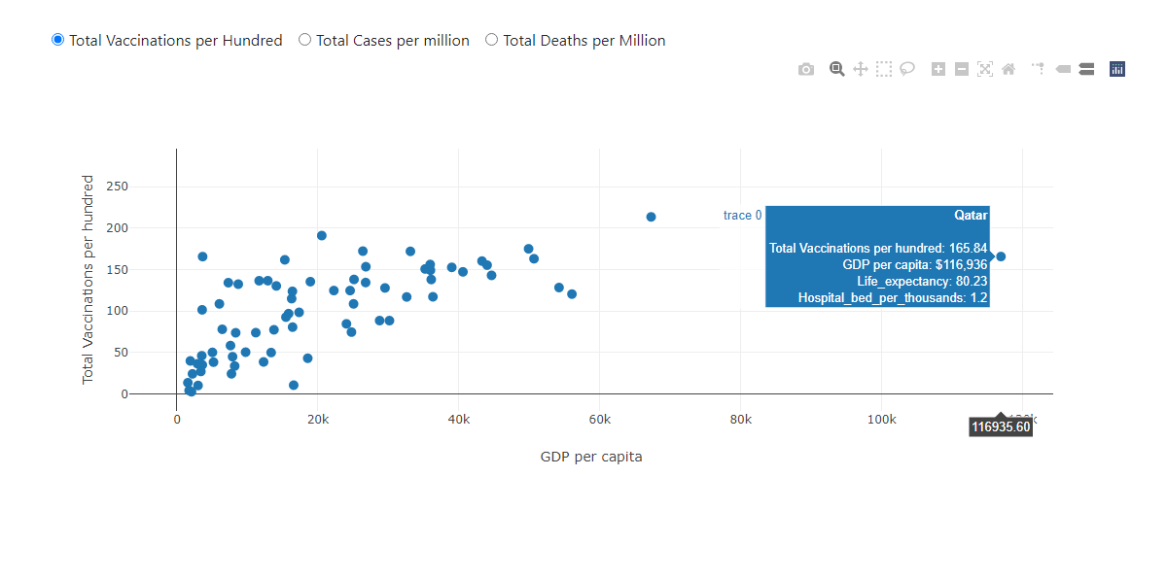
Interactive Scatter Plot - Total Vaccination
Countries with higher GDP have the higher number of total vaccination/100

Slide 13
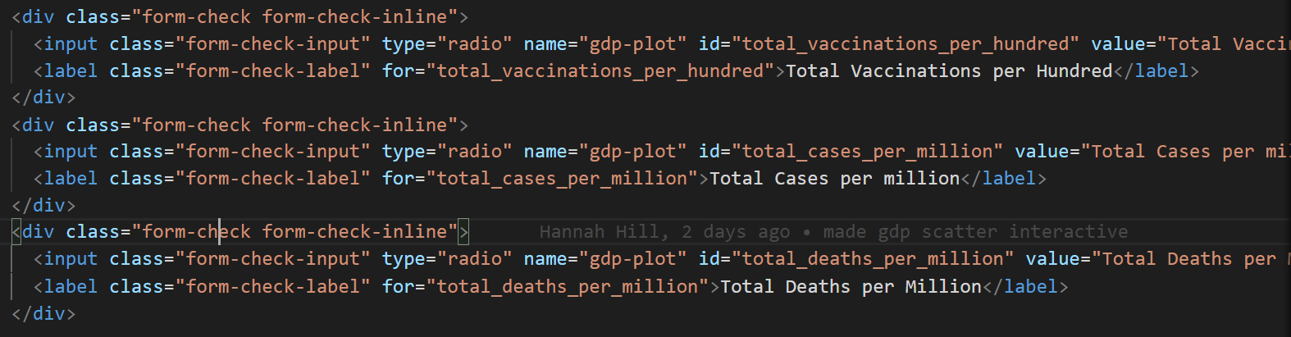
Interactive Scatter Plot - Radio Button

Slide 14
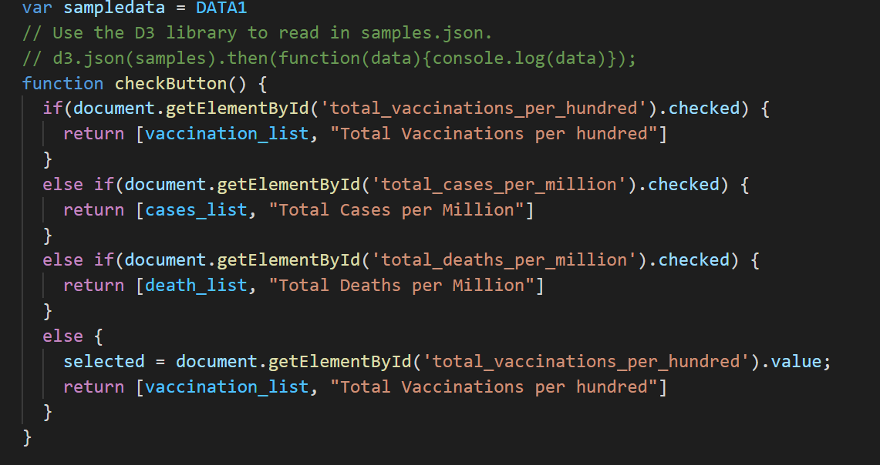
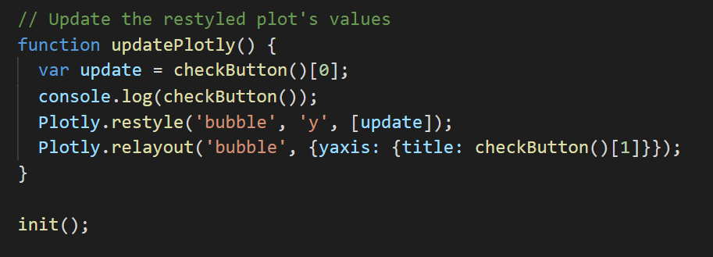

Slide 15
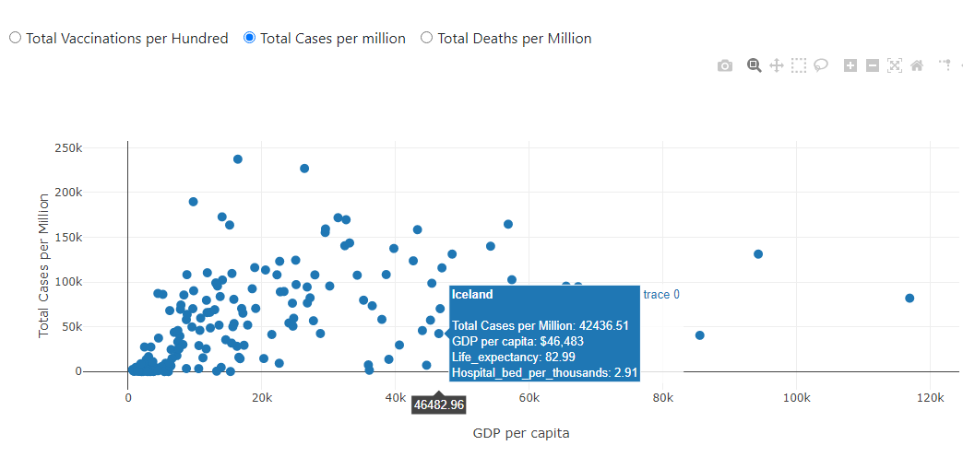
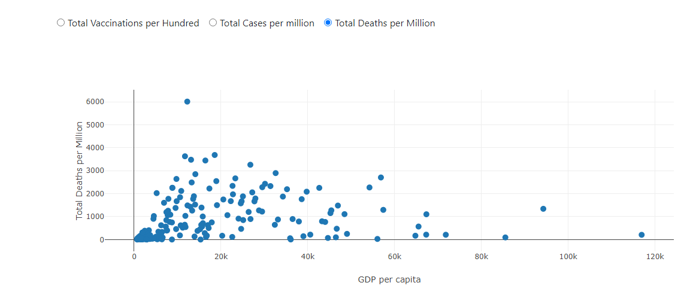
Interactive Scatter Plot- Total Cases per million & total deaths
Countries with lower GDPs have the higher total cases and total deaths

Slide 16
Sahar’s plots …………….
Sahar tell your story her ☺

Slide 17


